Slide 1
Task 2 Bug hunting using Netsparker
Reported by – Asawari More

Slide 2
Index
screenshot of Netsparker found vulnerabilities.
Report: basic details.
Vulnerability Details.
Impact
Remedy.

Slide 3
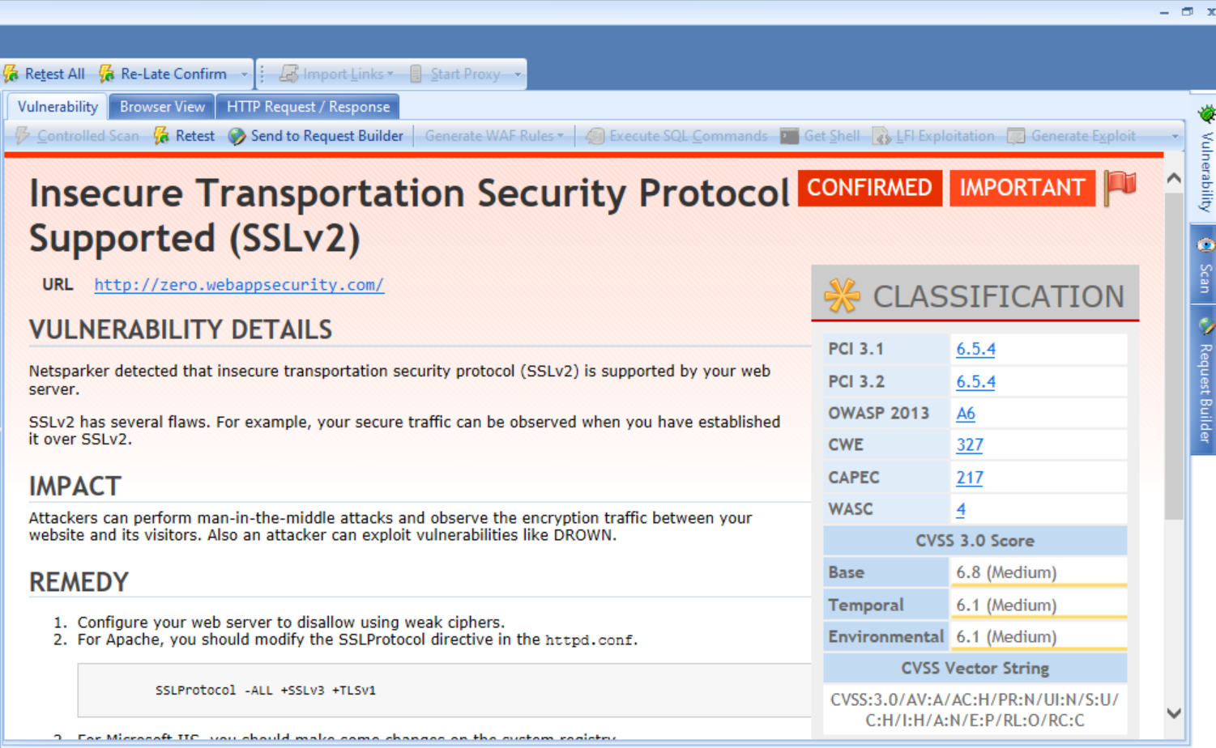
Screenshot

Slide 4
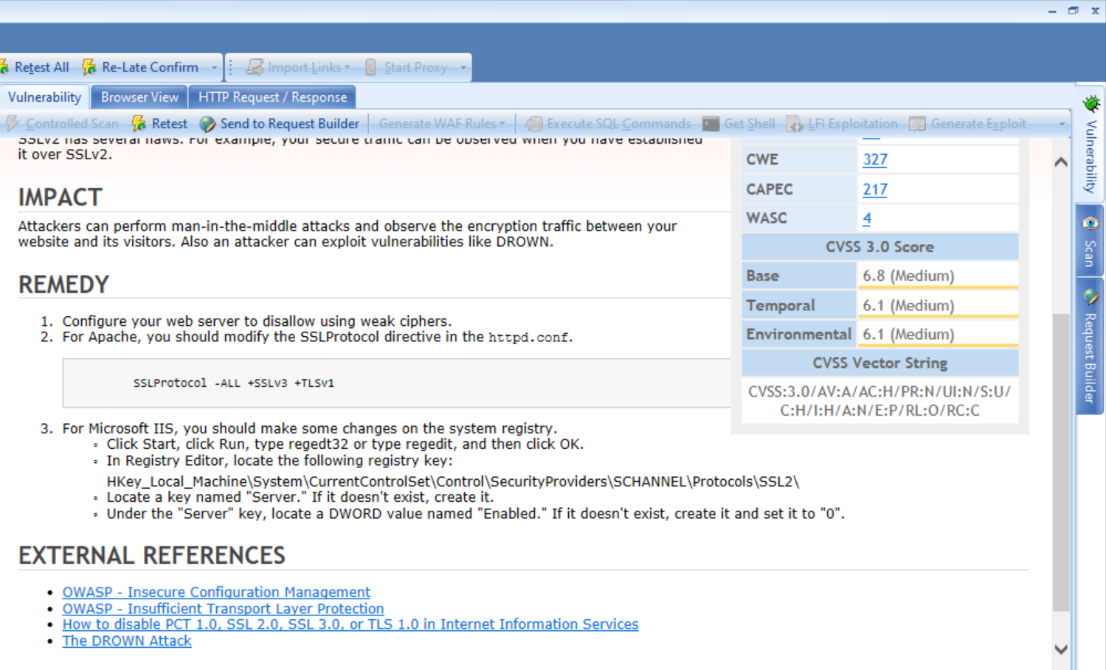

Slide 5
Report : Basic Details
Vulnerability Name: Insecure Transportation Security Protocol Supported (SSLv2)
URL: http://zero.webappsecurity.com/
Domain Name – Webappsecurity.com
Subdomain Name – zero.webappsecurity.com
CVSS: 3.0 Score
CVSS Vector String: 3.0/AV:A/AC:H/PR:N/UI:N/S:U/C:H/I:H/A:N/E:P/RL:O/RC:C
Severity: Important /Critical
Priority: High
Reason: Insecure SSLv2 detected
Status: Active
Environment : Windows 10

Slide 6
Vulnerability Details
Insecure transportation security protocol (SSLv2) is supported by your web server zero.webappsecurity.com.
SSLv2 is older implementation of the secure Socket Layer Protocol. So, it suffers from a number of security flaws allowing attacker to capture and alter information passed between client and the server. Attacker can observe your secure traffic when you have established it over SSLv2.

Slide 7
Impact
No protection from against man-in-the-middle attacks during handshake.
Attacker can easily perform man-in-the-middle attack and can easily retrieve information and can also observe the encryption traffic between website and client or visitors.
Also an attacker can exploit vulnerabilities like DROWN. It can affect all type of servers. So, attacker can easily break weak encryption to read/steal data and can get public key credentials between the two protocols.
As your website support sslv2, an attacker can decrypt a TLS ciphertext in one minute on a single CPU. DROWN is a serious vulnerability that affects HTTPS and any other services that use SSL and TLS.

Slide 8
Remedy
Disallow using weak ciphers.
Modify SSLv2 protocol. It might decrease possibility of man-in-the middle attack.
Modify the SSL Protocol directive in the httpd.conf for Appache.
Modify the SSLv2 protocol to SSLv3 and TSLv to TSLV1.
For Microsoft IIS, make some changes on the system registry.
Click Start, click Run, type regedt32 or type regedit, and then click OK.
In Registry Editor, locate the following registry key: HKey_Local_Machine\System\CurrentControlSet\Control\SecurityProviders\SCHANNEL\Protocols\SSL2\
Locate a key named "Server." If it doesn't exist, create it.
Under the "Server" key, locate a DWORD value named "Enabled." If it doesn't exist, create it and set it to "0".

Slide 9
Thank you!!!!!

